Slide 1



Augmented Resource Allocation Framework for Disaster Response Coordination in Mobile Cloud Environments
Luke Guerdan
Department of Computer Science,
University of Missouri
^{Olivia Apperson, Prasad Calyam}

Slide 2
Agenda
Introduction and Motivation
Resource Allocation During Disaster Scenarios
Solution Approach, and Methodology
Resource Allocation Problem Formulation
An ICN Approach to Response Optimization
ARA Framework Architecture
Dispatch Phase and Annealing Phase
Results and Conclusions
Case Study: Panacea’s Cloud
Simulation Results
Future Work

Slide 3
Disaster Situations are Frequent
Number of Disasters in the United States Each Year, 1980-2015
Center for Infrastructure Protection & Homeland Security, 2016
Notes:
Needs work. Maybe a comparison to internet access or some other figure / statistic to tie to this

Slide 4
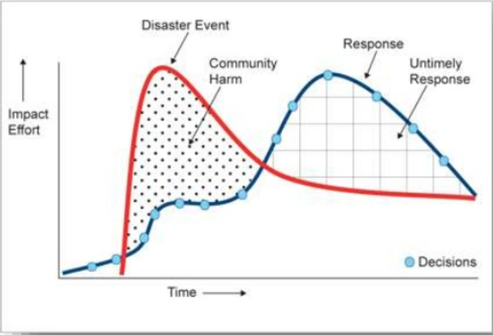
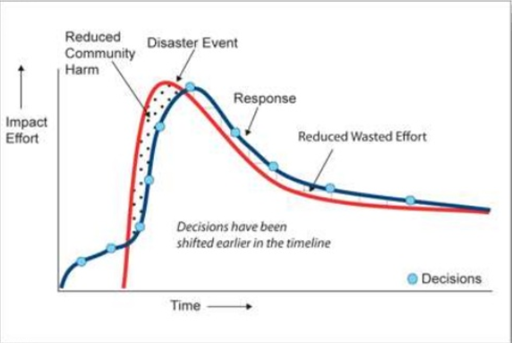
The Importance of Early Decisions
Effective early decisions lead to:
A more timely overall response
Reduced community harm
Less waste of resources
Current Disaster Management
Ideal Disaster Management
Department of Community Safety, Queensland Govt. & UNOCHA, 2011

Slide 5
Difficulty Allocating Disaster Resources
Many factors make dispatching emergency resources difficult:
Infrastructure Damage
Examples: blocked roadways, downed communication networks
Challenge: How to be aware of and account for this?
Situation is Dynamic
Examples: intermittent internet access, unaware of current conditions
Challenge: How to make network fault tolerant and robust?
Many First Responders and Patients
Examples: doctors, EMTs, firefighters, national guard
Challenge: What is an optimal responder-patient pairing?
Time Sensitive
Examples: patients needing medical care, area evacuation
Challenge: How to expedite the disaster response?

Slide 6
Strategies in Disaster Management
Centralized Information Storage & Retrieval
DIORAMA management system [Ganz, et. al. 2011]
Fault tolerant mobile networks [Trono, et. al. 2015]
Analytic Hierarchy Process
Weighted decision making criteria [Hauenstein, et. al. 2006]
Prioritization over vehicular networks [Alazawi et. al. 2011]
Latest: ICN approach to disaster management

Slide 7
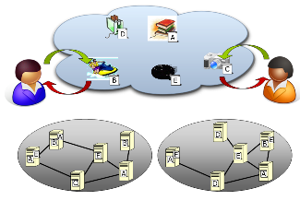
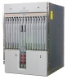
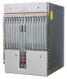
Information Centric Networking
Information Centric Network
Focus on information objects
Today’s Internet
Focus on
nodes
Focus on information objects
Rather than node-to-node
connections
Information-Centric Networking (ICN) targets general infrastructure that provides in-network caching so that content is distributed in a scalable, cost-efficient & secure manner
Decouples “what” from “where”
Subscribe/get objects of interest
Support for location transparency, mobility & intermittent connectivity

Slide 8
Recent Notable Works on Mobile Cloud Based Disaster Management and their Limitations
Related work | Strengths | Limitations
Choosumrong et.al. (‘12) | Multi-criteria based approach to allocating resources | Criteria weights are static each disaster
Alshareef et. al. (‘14) | Central information storage with phone-to-phone sharing | Reliant on SMS messages during downed network
Aydin, et. al. (‘16) | System hosted entirely on mobile phones | Requires pre-incident configuration
Singh et. al. (‘14) | Criteria weights are dynamic during incident | Limited to a vehicular network context
Gillis et. al. (‘15) | Provides end-to-end disaster management solution | Information processing is primarily passive

Slide 9
Our Research Goals
Rigorously define the disaster resource allocation problem
Optimize disaster response by integrating:
Centralized information storage
Human knowledge of the situation
Dynamic routing algorithms
Provide a flexible end-to-end recommendation system for integrating disaster information with decision making
Evaluate system for future improvements

Slide 10
ARA Novelty
Our framework leverages online and offline capabilities
Previous works reliant on SMS messaging or the cloud
Our framework is agnostic to the disaster
Previous works tailored to medical or vehicular context
Our framework has well integrated info processing
Previous works require manual aggregation
Our framework provides active suggestions
Previous works only provide passive data
We also provide new metrics for assessment of disaster response

Slide 11
Agenda
Introduction and Motivation
Resource Allocation During Disaster Scenarios
An ICN Approach to Response Optimization
Solution Approach, and Methodology
Resource Allocation Problem Formulation
ARA Framework Architecture
Dispatch Phase and Annealing Phase
Results and Conclusions
Case Study: Panacea’s Cloud
Simulation Results
Future Work

Slide 12
Resource Allocation Primitives
The Incident-Response (I-R) Cycle
Incident: A geotemporally distinct intersection of one or more responders and respondees. Has a definitive time and location.
Responder:
A person, resource, or material applied
to reduce the severity of a disaster scene
Respondee:
A person or resource requiring assistance from a responder
Resource Allocation

Slide 13
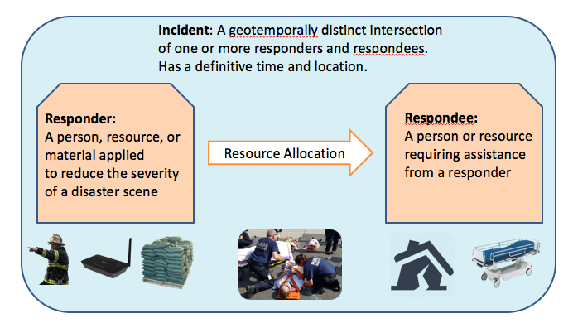
Resource Allocation Primitives Cont.
Serial I-R Cycles
Parallel I-R Cycles
Parallel I-R Cycles involve multiple incidents in each time interval, while serial only one

Slide 14
Three Key Metrics
Timeliness
Minimizing the time respondees are waiting for care
Optimizing response time by selecting the fastest route and closest responder
Making responders available for additional scenes
Quality of Care
Finding the optimal responder for a given respondee
Maximizing likelihood of a positive outcome each scene
High priority respondees receive attention first
Responder Leverage
Finding optimal respondee for a given responder
Responders should be well suited for a given situation
Tradeoff between sending many to one incident and dispersing
Optimized in conjunction with quality of care

Slide 15
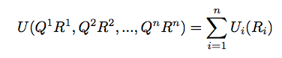
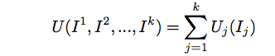
Maximizing Effectiveness of a Disaster Response
An optimal response to a particular incident-response cycle can be found by maximizing the utility of each pairing.
Given n respondees {P₁, P₂ , …, P_{n}} and m responders {B₁, B₂, …, B_{m}}, let there
be k pairings of one or more responders and respondees be { R₁, R₂, … , R_{k}} (k ≤ n , k ≤ m)
Let each pairing quality Q_{k} denote the quality of the match based on the three key factors
Quality of fit
Timeliness
Responder leverage
Then the I-R utility can be calculated by maximizing
Once this is achieved, the disaster response utility can be found be maximizing
Notes:
This needs a slide maybe to tie optimization here to the solution

Slide 16


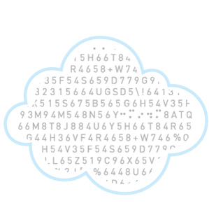
ARA Framework Architecture

Slide 17
The Dispatch Phase
Information directed from Human Plane through Control Plane, results in changes in the Data Plane
Incident commander presented with recommended action based on optimal calculation
Either selects recommended action or a ‘suboptimal one`
Decision has effect on the Control Plane
Control plane changes cascade to outcomes in Data Plane
Notes:
Needs more detail probably

Slide 18
The Augmented Annealing Phase
Information changes in the Data Plane are aggregated back up through the Control Plane to the Human Plane
The selected decision (vehicle route, responder-respondee pairing) is compared with the recommended one
I-R cycle outcome reinforces future recommendations if positive outcome
Prediction weights updated based on incident outcome and reflected in future dispatch phases
Notes:
This needs a slide maybe to tie optimization here to the solution

Slide 19
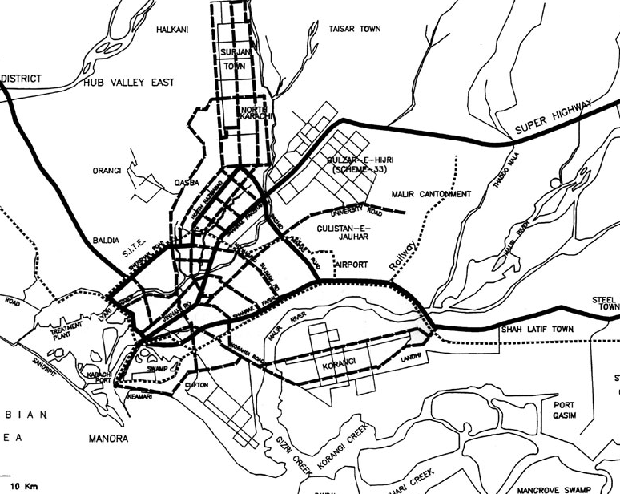
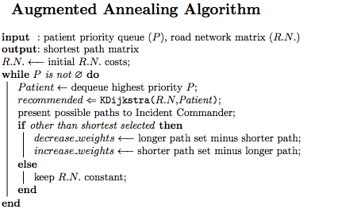

Notes:
Slide animated

Slide 20
Agenda
Introduction and Motivation
Resource Allocation During Disaster Scenarios
An ICN Approach to Response Optimization
Solution Approach, and Methodology
Resource Allocation Problem Formulation
ARA Framework Architecture
Dispatch Phase and Annealing Phase
Results and Conclusions
Case Study: Panacea’s Cloud
Simulation Results
Future Work

Slide 21
Panacea’s Cloud
Previous work: disaster response application
hosted over an ad hoc network in a mobile cloud
J. Gillis, Panacea’s Glass: Mobile Cloud Framework for Communication in Mass Casualty Disaster Triage, IEEE Mobile Cloud 2015

Slide 22
Field Test Methodology
Partnered with Missouri Task Force One, a disaster response unit deployed to emergencies (Superstorm Sandy, Katrina)
Simulated disaster response by placing emergency markers around a field
Responders log and respond to incidents
Information on Data Plane aggregated through Control Plane and presented on Human Plane
Compare response time under different conditions
Three conditions:
Current protocol using Garmin handheld devices
Following ARA Framework (log data using Recon Jet)
Following ARA Framework (log data using mobile phone)

Slide 23
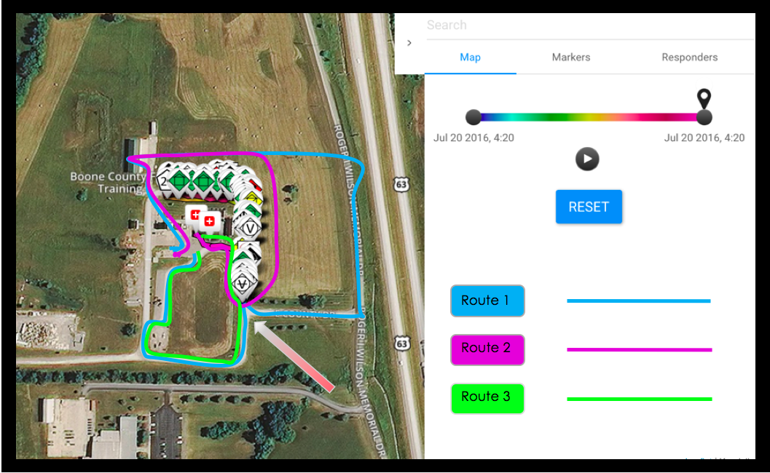
Panacea’s Cloud Dashboard

Slide 24
Field Test Interpretation
Dispatch Phase
IC makes a decision having effects on the scenario
Human Plane: multiple pairings and paths recommended to IC
Control Plane: path selected, responders follow accordingly
Data Plane: incident outcome represented by situation changes
Augmented Annealing Phase
Data Plane: updated disaster scenario changed from previous dispatch phase
Control Plane: shortest path recommendation updated
Human Plane: dashboard recommendations reflect updated scenario
Notes:
Maybe add quantitative data from field test? This ok?

Slide 25
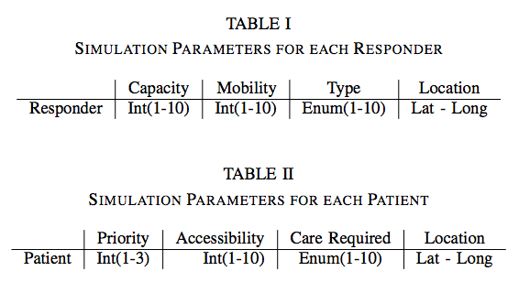
Simulation Methodology
Simulate response to medical triage scenario
Pair responders to respondees to find optimal response
Consider two conditions:
Human Selected: IC makes decisions using suggestions of ARA Framework
Random Pairing: IC pairs ”randomly” without additional information
Compare quality dimensions responder leverage, timeliness, QoC
Compared across various theater sizes:
4, 10, 25, 100, 200 respondees
5, 15, 40 responders

Slide 26
Simulation Visualization

Slide 27
Results: Quality Dimensions
Each dimension measured on 1-10 scale
Human selected condition more optimal in each quality dimension
Timeliness – 19.5% increase
Responder Leverage – 105.7% increase
QoC – 30.3% increase

Slide 28
Results: Training Overhead
Training Overhead: Calculated by average seconds model takes to run per I-R cycle under human selected condition
Generate suggestions, present to incident commander, update weights
Compare training time in seconds as function of different incident sizes
55.8% increase in overhead for largest triage theater
- (200 patients, 40 responders) vs (200 patients, 5 responders)
EMS professionals categorize 25 patients as large incident size threshold

Slide 29
Conclusions
Human selected pairings using ARA improves response across quality dimensions
Defining optimization scheme allows for objective analysis of response performance
Using ICN as a research angle for optimizing disaster response is valid
ARA incurs a lot of overhead in large theatres
Not an issue in small and moderate conditions

Slide 30
Future Work
Conduct more live testing of ARA with first responders to fine-tune dispatch and annealing phases
Training overhead: find methods of adjusting for training overhead in large response theatres
Refine ICN model of interpreting disaster response
Apply model to parallel I-R cycles

Slide 31
Special Thanks To:
Sal Ahmad, University of Missouri School of Medicine
Kendall Park, University of Missouri
Dave Webber, Missouri Task Force One
John Gillis, University of Missouri
Kourtney Meiss, Wofford College
Ev Chang, Vassar College
Josiah Burchard, Missouri State

Slide 32
Acknowledgements:
Thank You! Questions?
This material is based upon work supported by the National Science Foundation under Award Number: CNS-1359125 and Coulter Foundation. Any opinions, findings, and conclusions or recommendations expressed in this publication are those of the author(s) and do not necessarily reflect the views of the National Science Foundation or Coulter Foundation.

